Slide 1
Comparison of Apache Spark and Hadoop MapReduce
U.H.K Prabhash – 248259E

Slide 2
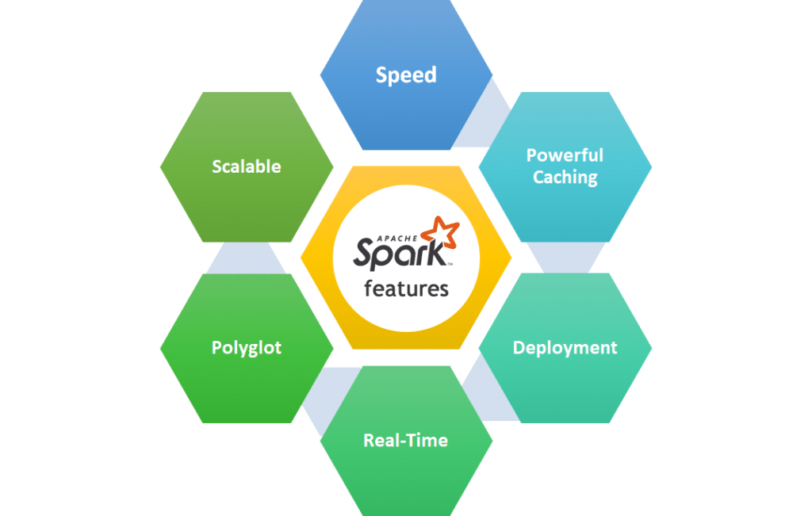
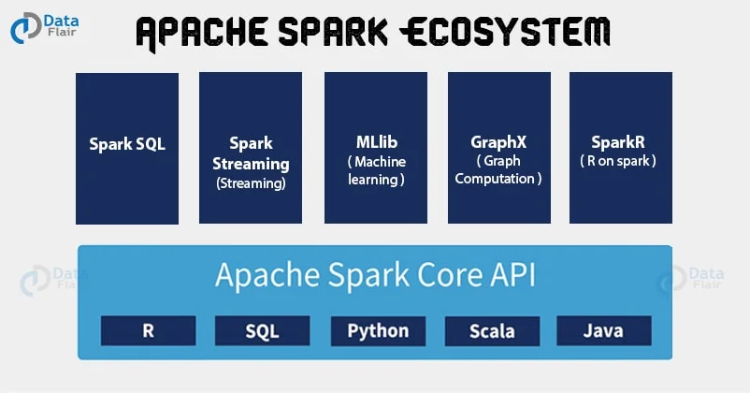
What is Apache Spark?
Apache Spark is a powerful, open-source, distributed computing system that provides an interface for programming entire clusters with implicit data parallelism and fault tolerance.
Source: https://proedu-organization.medium.com/understanding-apache-spark-architecture-5e3427c7d229
Source: https://data-flair.training/blogs/apache-spark-ecosystem-components/

Slide 3
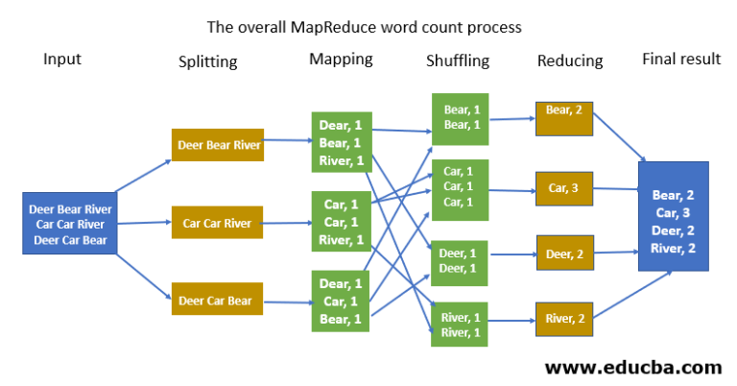
What is Hadoop MapReduce?
Hadoop MapReduce is a software framework for easily writing applications which process vast amounts of data(multi-terabyte datasets) in-parallel on large clusters of commodity hardware in a reliable, fault-tolerant manner.
Source: https://www.educba.com/mapreduce-word-count/

Slide 4
Demo

Slide 5
Results

Slide 6
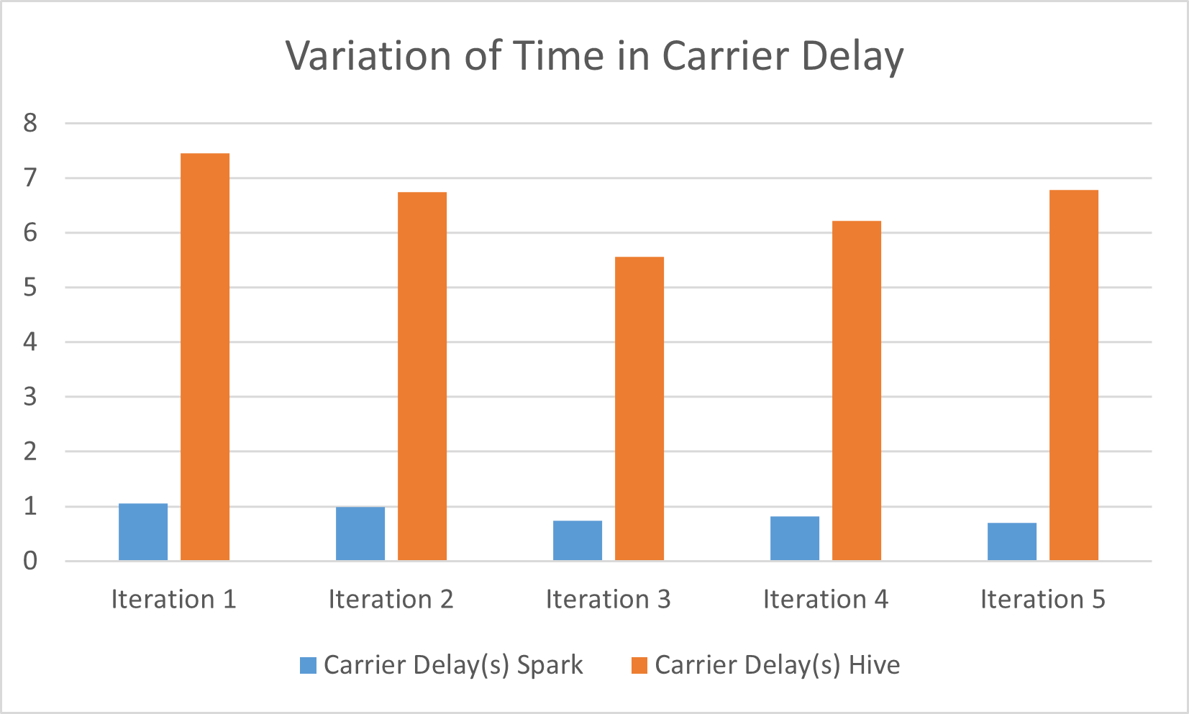
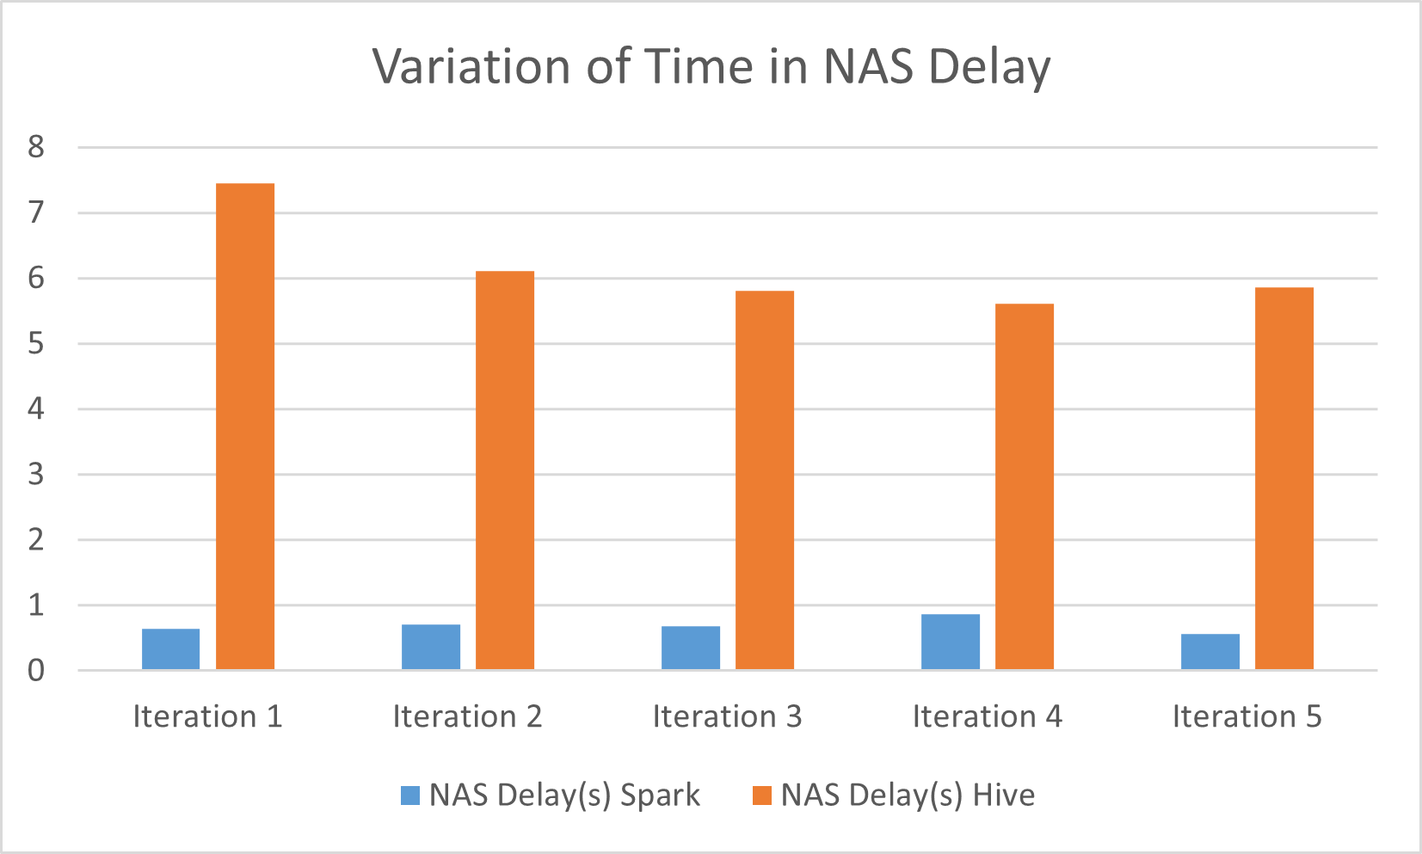
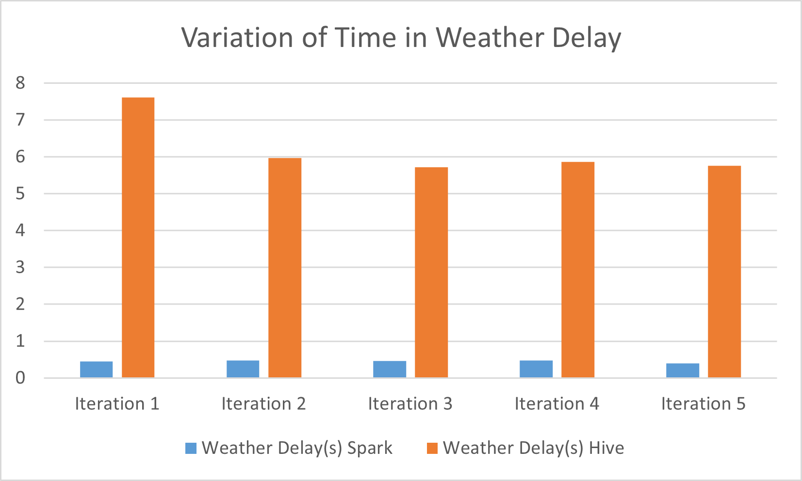
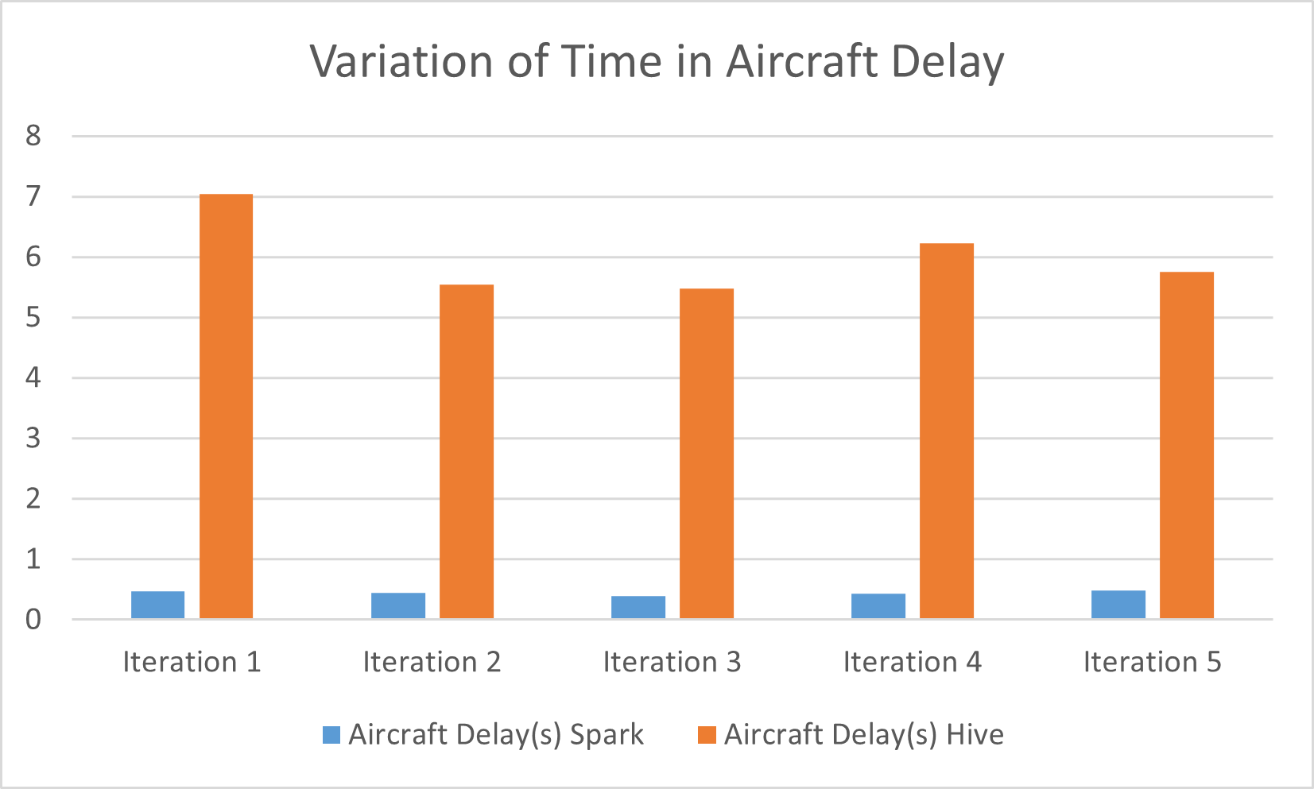
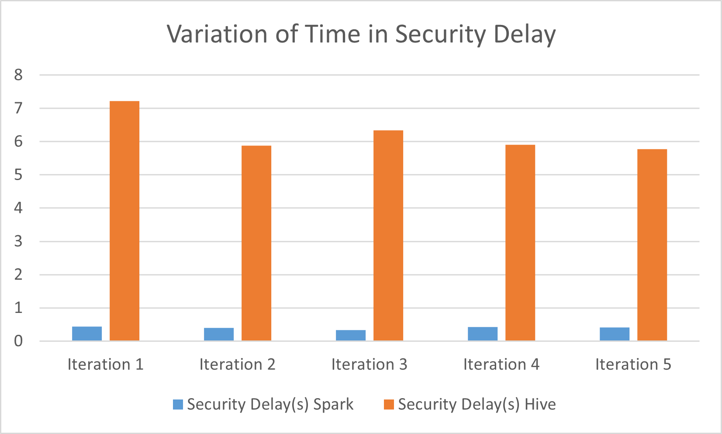
Variation of Time in Each Delays

Slide 7
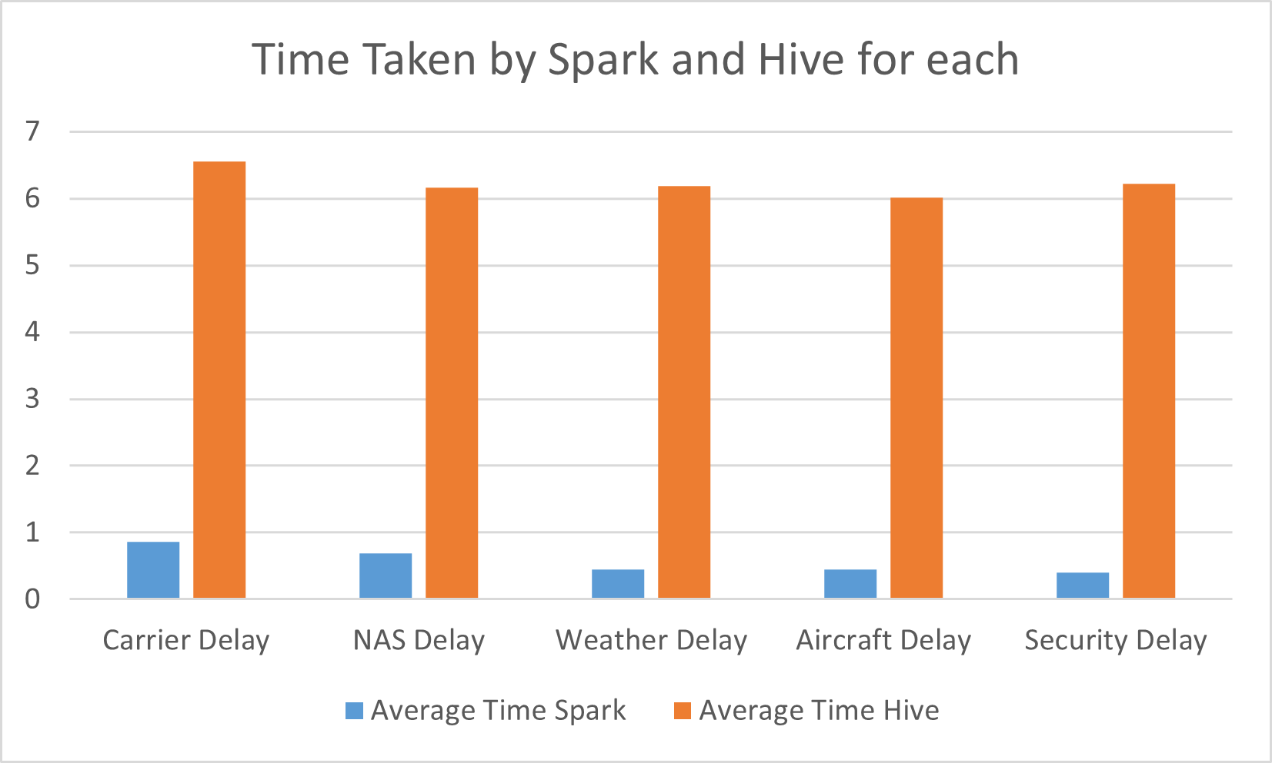
Average Variation of Time in Each Delays

Slide 8
Apache Spark vs Hadoop MapReduce
 | Apache Spark | Hadoop MapReduce
Performance | Have high in memory capability which allows it to run faster. Useful when using iterative algorithms such as machine learning with larger dataset | For large-scale, linear data processing tasks that can be efficiently partitioned into map and reduce tasks, MapReduce can be very effective and scalable.
Ease of Use | Spark provides high-level APIs in Java, Scala, Python, and R, making it more accessible to users. | Provides a more verbose and lower-level API, which can make it more difficult to program, especially for those who are new to distributed computing.

Slide 9
Thanks!

